Slide 1



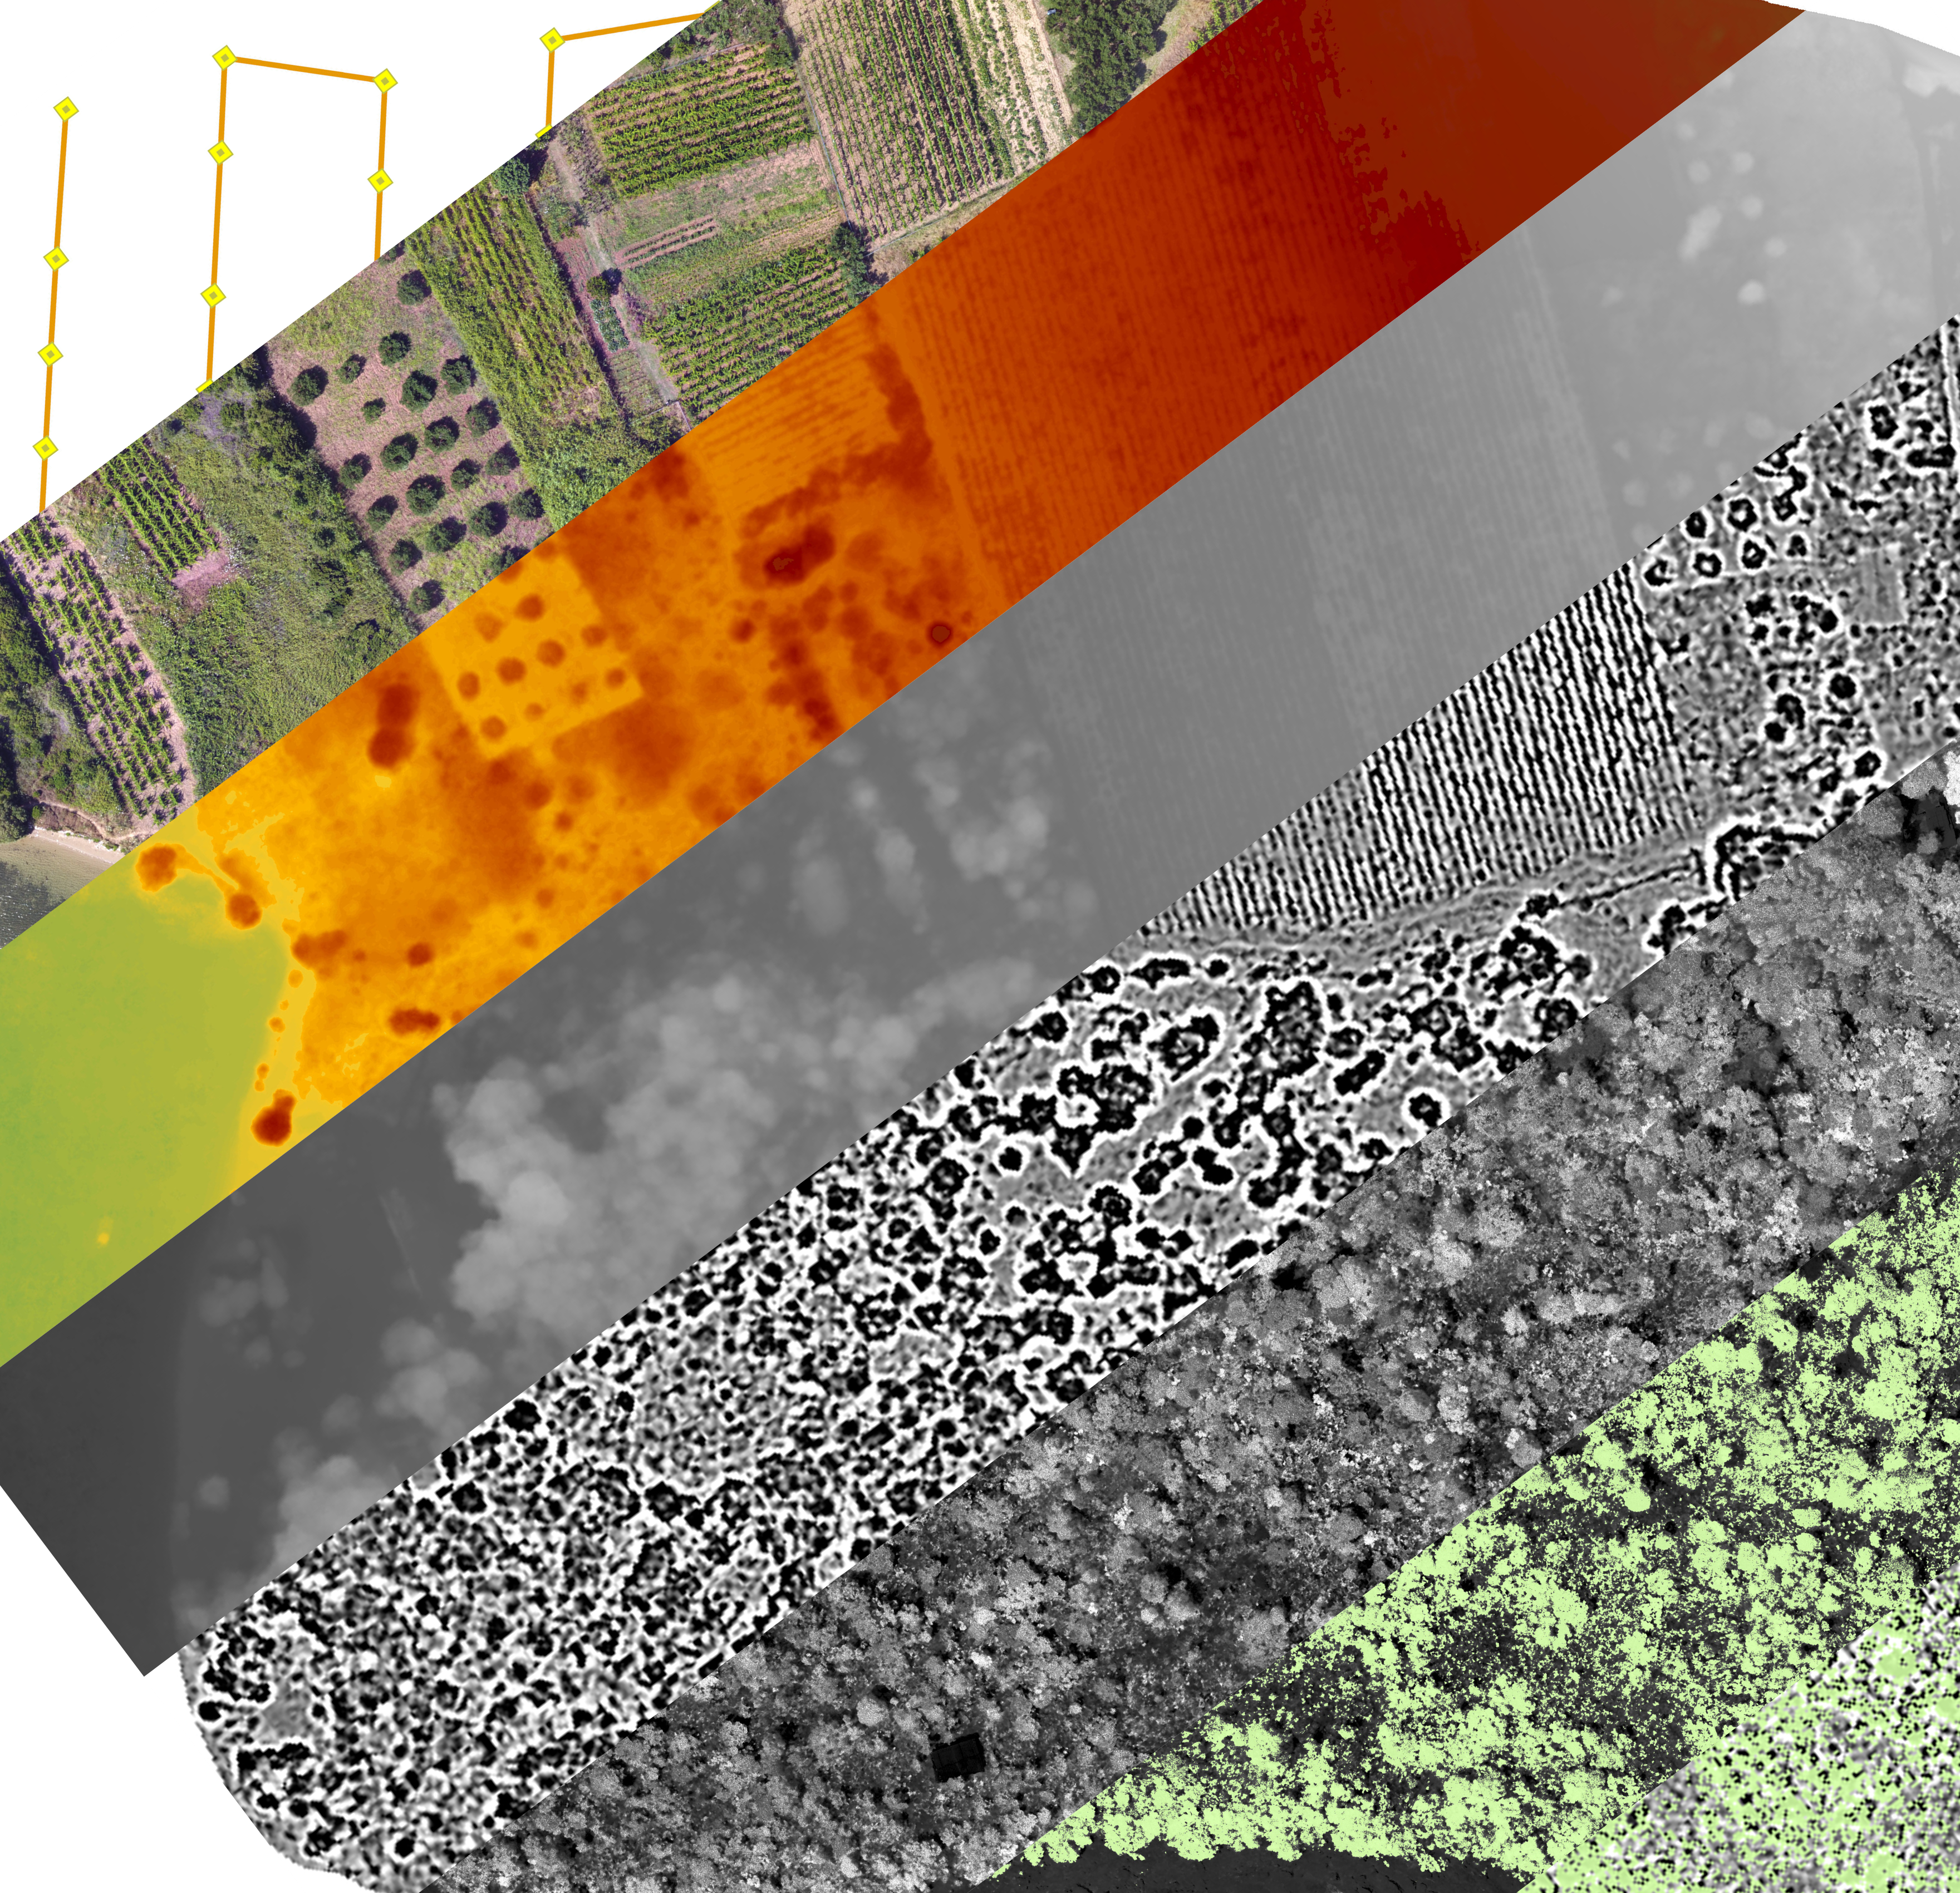

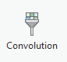
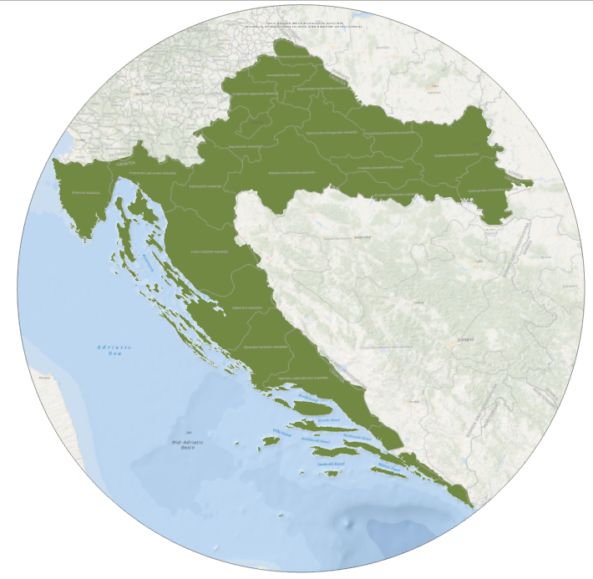

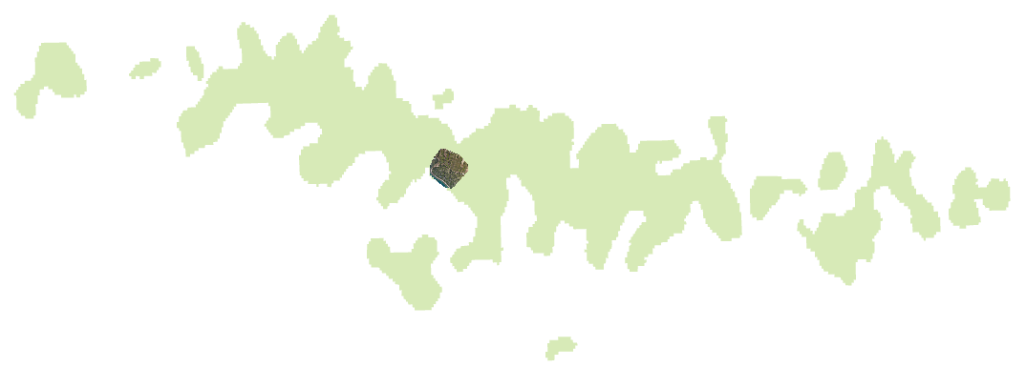
Alice Ready Paul Lorah Sustainability Scholar Grant Summer 2018
Drones, Landscape and Archaeology
Introduction
Remote sensing via aircrafts and satellites is significantly helpful to archaeological efforts, especially for site analysis and targeting excavation efforts (Kelley et al. 2017). Unfortunately, most of this imagery is very low resolution, making detecting change on small-scale sites very difficult (Tang et. al 2015). Where acquiring remotely sensed data via aircrafts and satellites is costly and generates low resolution images, drones are an increasingly valuable archaeological tool.
The archaeological work at this site has not yet implemented this drone technology to map the site or to study the relationship between the environment and ancient human sites. This research greatly contributes to the preservation of Croatian cultural and archaeological heritage and to the local community development.
Methodology
Generating a study area:
Firstly, preliminary flight patterns of our study area will be generated in DJI and MapPilot apps. Within this app I will establish altitude, area, distance, flight duration, speed, photo resolution, photo overlap, and number of photos. The flights would collect overlapping images (resolution 2.6cm/px) that are geotagged with a corresponding latitude, longitude, and elevation.
Processing:
The aerial imagery and data collected by the drone will be processed in the ArcPro ortho mapping software. This program overlays and mosaics images to generate a series of map layers depicting the archaeological site and surrounding environment. These include: digital surface models, digital terrain models, and a 3D orthomosiac images.
Study Area
St. Clement Island is an ideal site as it showcases many ancient built features tied to sea and land resources such as water, arable lands, salt works, stone quarries, and fisheries.
Convolution Function:
In order to extract bare ground and straight lines that indicate ancient and contemporary human features, the convolution function is applied. The convolution function performs filtering on the pixel values in an image, which can be used for sharpening, blurring, detecting edges, or other kernel-based enhancements within an image. All convolution functions were applied to the digital surface model. Firstly, we applied the smoothing 3x3 convolution function to DSM.
This is a product of applying Lapacian 3x3 to the previous smoothed layer. Laplacian filters are often used for edge detection, and are often applied to an image that has first been smoothed to reduce its sensitivity to noise. Notice as edges stand out much more in this layer than the previous maps.
This project builds on past research of a Roman villa in Soline Bay (Begović, et al.2012, 143-166) conducted by St. Thomas faculty and students.
© File copyright Colin Purrington. You may use for making your poster, of course, but please do not plagiarize, adapt, or put on your own site. Also, do not upload this file, even if modified, to third-party file-sharing sites such as doctoc.com. If you have insatiable need to post a template onto your own site, search the internet for a different template to steal. File downloaded from http://colinpurrington.com/tips/academic/posterdesign.
NDVI Tool:
The next step involves masking out vegetation, as our goal is to study the ground in which built features exist. We first use the NDVI indices to better contrast vegetation from ground surfaces. Changing the color bands of the orthographic makes certain features more visible. "The normalized difference vegetation index (NDVI) is a standardized index allowing you to generate an image displaying greenness, also known as relative biomass.
Raster Calculator:
Based on field observation and photo analysis the value of trees was chosen. Within the NDVI layer, vegetation contained pixel values greater than 0.13. Areas of dirt and human presence contained pixel values less than 0.13. In the raster calculator tool a vegetation layer is created using the equation "NDVI > .13"
Results
Drone technology allowed us to generate a study area and acquire high resolution images. Through ArcPro OrthoMapping we processed an orthomosaic and digital elevation model depicting the landscape.
Thus, we were able to successfully mask out vegetation that blocked ground level features below and able to extract built features from the landscape. This research demonstrates that drones are a useful tool in archaeological research and effectively highlights target areas of potential archaeological significance.
Overlay of vegetation layer on top of filtered convolution layer. Now edges that indicate ancient and contemporary human features are clear.
Research Question
This research highlights target areas of potential archaeological significance by extracting edges which are proxies for human presence. In addition, vegetated areas mapped are isolated as vegetation obscures ground level features. This is accomplished by:
Generating a study area
Conducting flights and acquiring high resolution georeferenced images
Processing images in GIS environment to create useful primary layers including orthomosaics and digital elevation models
Modeling landscapes from primary layers to extract straight lines
Using NDVI tool to depict presence of vegetation, this layer was then used to mask portions of the landscape obscured by vegetation.
By creating detailed maps of contemporary and ancient human features we gained useful insight regarding how these human features relate and reflect the environment. This research not only assists in the archaeological research of the site but also contributes to the general knowledge of historical rural settlements on St. Clement.
Processed map after convolution filtering and extracting vegetation.
Orthomosaic image before convolution and extracting vegetation
Special Thanks:
Professor Ivancica Schrunk
Marinko Petrić – Hvar Heritage Museum
Literature Citied
Anderson, David G., et al. "Climate and culture change: exploring Holocene transitions." Climate Change and Cultural Dynamics. 2007. 1-23.
Begović, Vlasta, Ivančica Schrunk, and Marina Ugarković. 2012. "Rimska Vila U Uvali Soline Na Otoku Sv. Klement Kod Hvara Preliminarna Analiza Arhitekture Prema Geofizičkom Istraživanju i Sondiranju."Prilozi Instituta Za Arheologiju U Zagrebu Vol. 29: 143-166.
Davies, Matthew I. J., and Freda Nkirote Joy M'Mbogori. Humans and the Environment New Archaeological Perspectives for the Twenty-First Century. Oxford University Press, 2013.
Harper, Kyle. The Fate of Rome. Princeton University Press, 2017.
McAnany, Patricia A., and Norman Yoffee. "Questioning how different societies respond to crises." Nature 464.7291 (2010): 977.
Kelly, Robert L., and David Hurst Thomas. Archaeology. 6th ed., Cengage Learning, 2017.
Tang, Lina, and Guofan Shao. "Drone remote sensing for forestry research and practices." Journal of Forestry Research 26.4 (2015): 791-797.
Notes:
analyzing spatial patterns of controlled burns using UAVS
Drone technology in research of physical resources and ancient settlement patterns on St. Clement Island, Croatia

